Slide 1

WomenTechWomenYes
Canvassing Strategy
By Abishek Gollapudi, Zoey Herm, Max Staley

Slide 2


Project Overview
Background
WTWY annual summer gala is coming up!
Deliverable
Suggest subway stations to canvas and gather emails
Ideal Target
Email signup will convert to attendance or donation
Interfaces with women in tech
Already passionate
Might be passionate once exposed to WTYS!
Notes:
Zoey: I would suggest streamlining this because I don’t see how we can get everything else done in 6 minutes

Slide 3



Methodology
Stations that service primarily commuters
Stations near tech hubs
Commuter stations identification
Source: MTA data (May 2018)
Criteria:
High weekday:weekend ratio
High rush hour:mid-day ratio
Tech hub stations identification
Source: NYC open data
Criteria: Sample of 100 tech companies
High signup-to-engagement conversion
Technology platforms used:
Notes:
Our assumption was that canvassers would be most successful at stations where they would encounter the most tech workers.
We first used pandas to identify the highest-volume stations in NY’s subway system (data from May 2018 — we could add more data, but it’s unlikely to significantly change our recommendations.
Then we used two metrics to narrow it down to better candidates: weekday to weekend ratio, and rush-hour to midday ratio (we will explain this further shortly)
Finally — and this is the really exciting part — we/Abi used NYC open data to map candidate stations and tech employers to identify the stations that tech workers are most likely to use on their commutes
One thing our approach is missing is demographic data that could be used to optimize conversion rates (income, gender, values).

Slide 4
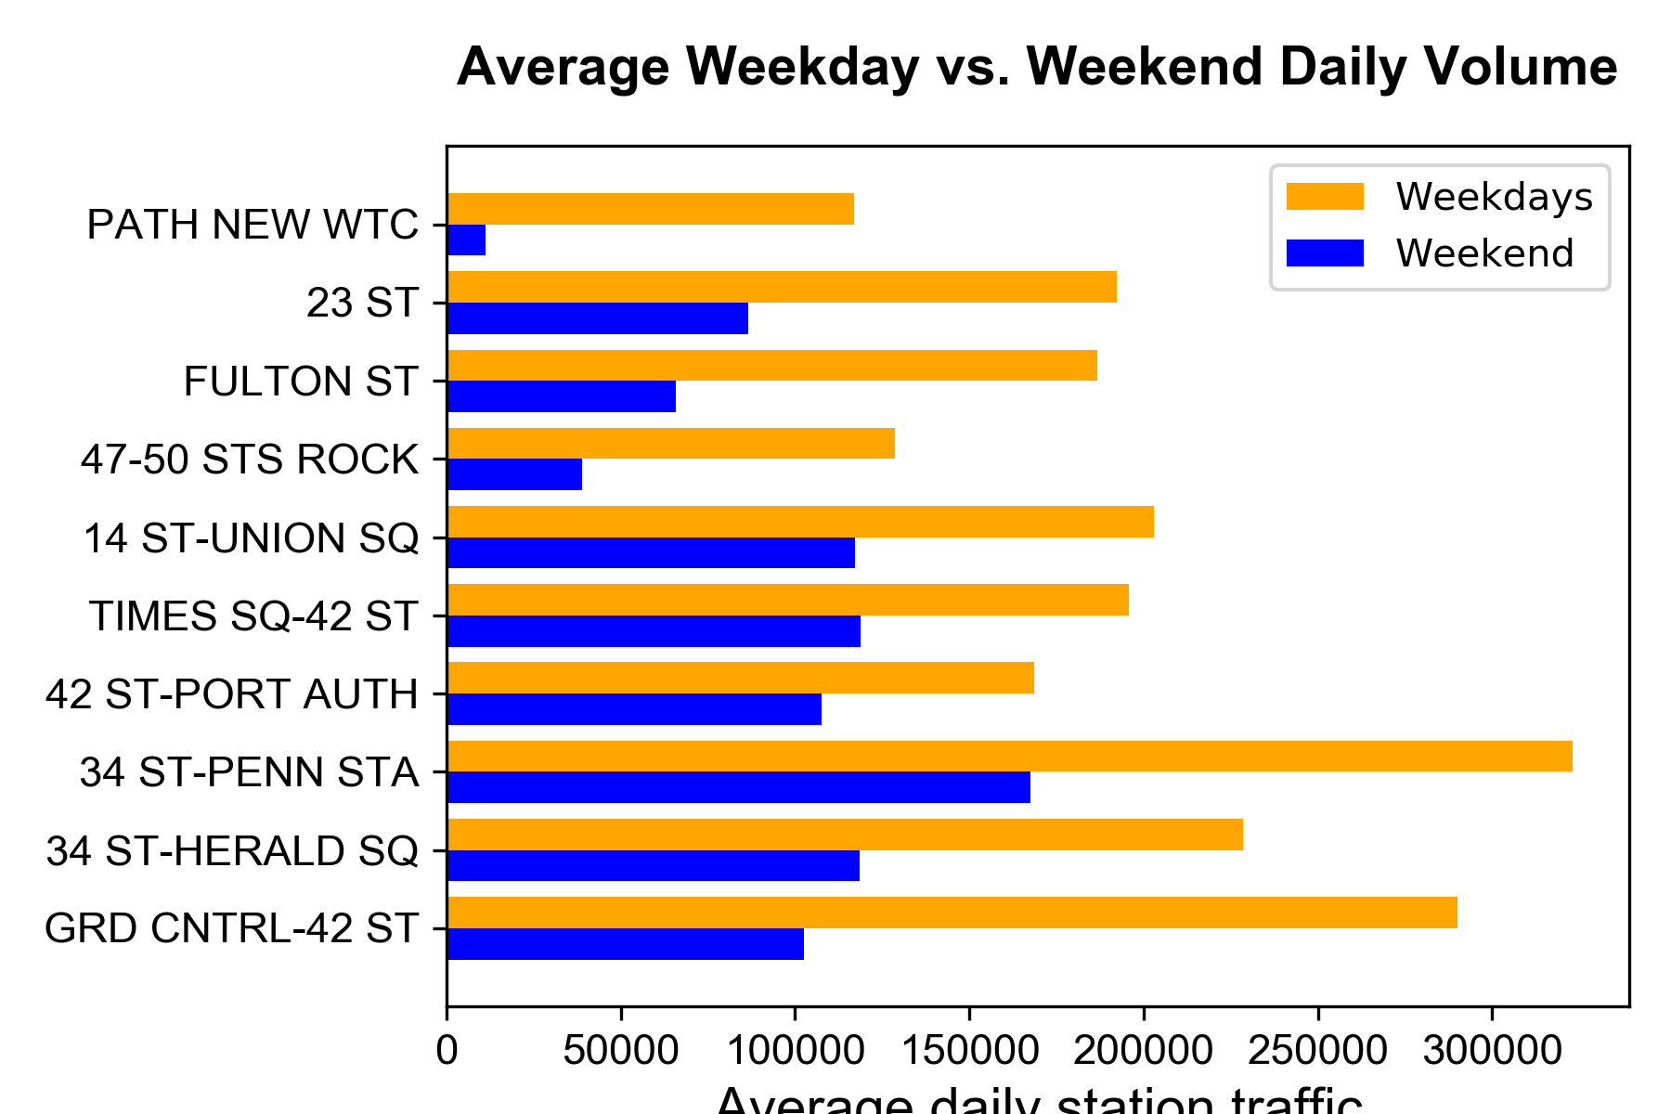
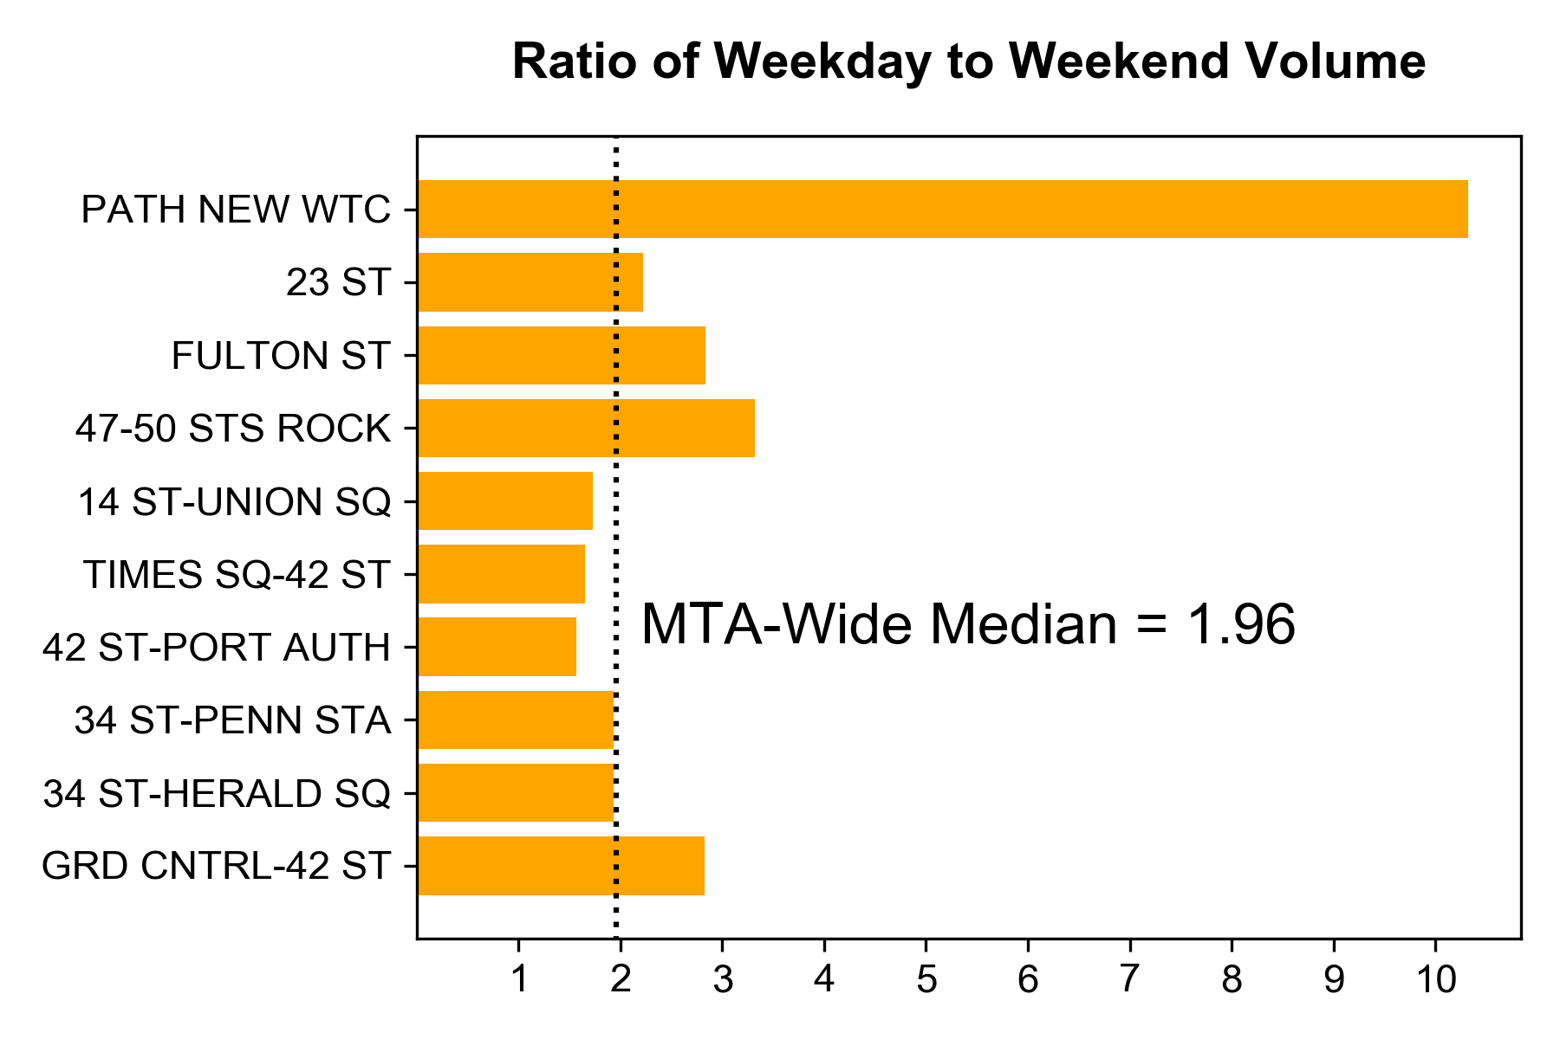
Weekday vs. Weekend Usage
Average daily station traffic
Ratio
Stations with relatively higher weekday volumes have relatively more commuters, as opposed to tourists and local residents.
Notes:
System-wide there are fewer riders during the weekend, but we wanted to see which stations have an especially large difference between weekend and weekday volume: these are probably used by lots of commuters, as opposed to tourists or residents doing things other than commuting.
There are two ways of looking at it: comparing the daily average volume (entries and exits) directly or the ratio of the averages.
The ratio is probably best for disqualifying stations: places like Times Square, Union Square etc. might have a lot of volume, but it seems like there’s lots of tourists there. On the other hand, the financial district has stations like WTC and Fulton where there are lots of commuters (based on this metric)

Slide 5
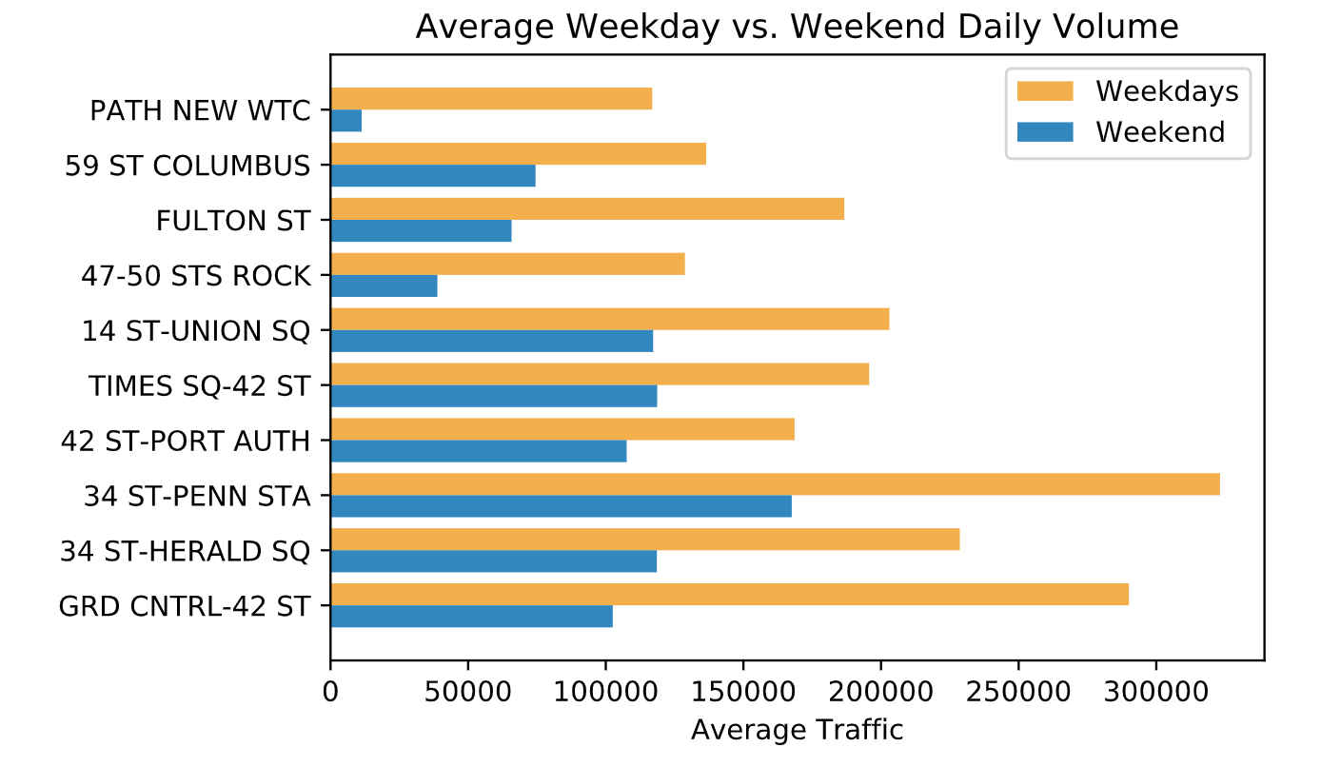
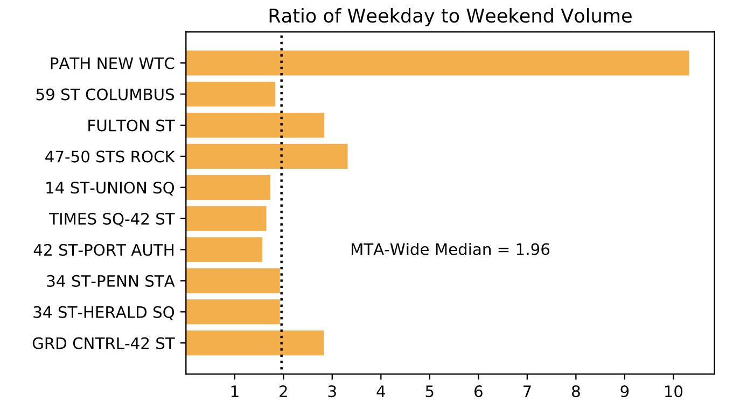
Weekday vs. Weekend Usage
Ratio
Stations with relatively higher weekday volumes have relatively more commuters, as opposed to tourists and local residents.
Notes:
This is pretty much a copy of the previous slide with slightly changed colors. These ones are in svg format so a little higher res but we can choose to go with the previous slide or this one depending on whichever one you guys think would be better for presenting. -Abi

Slide 6
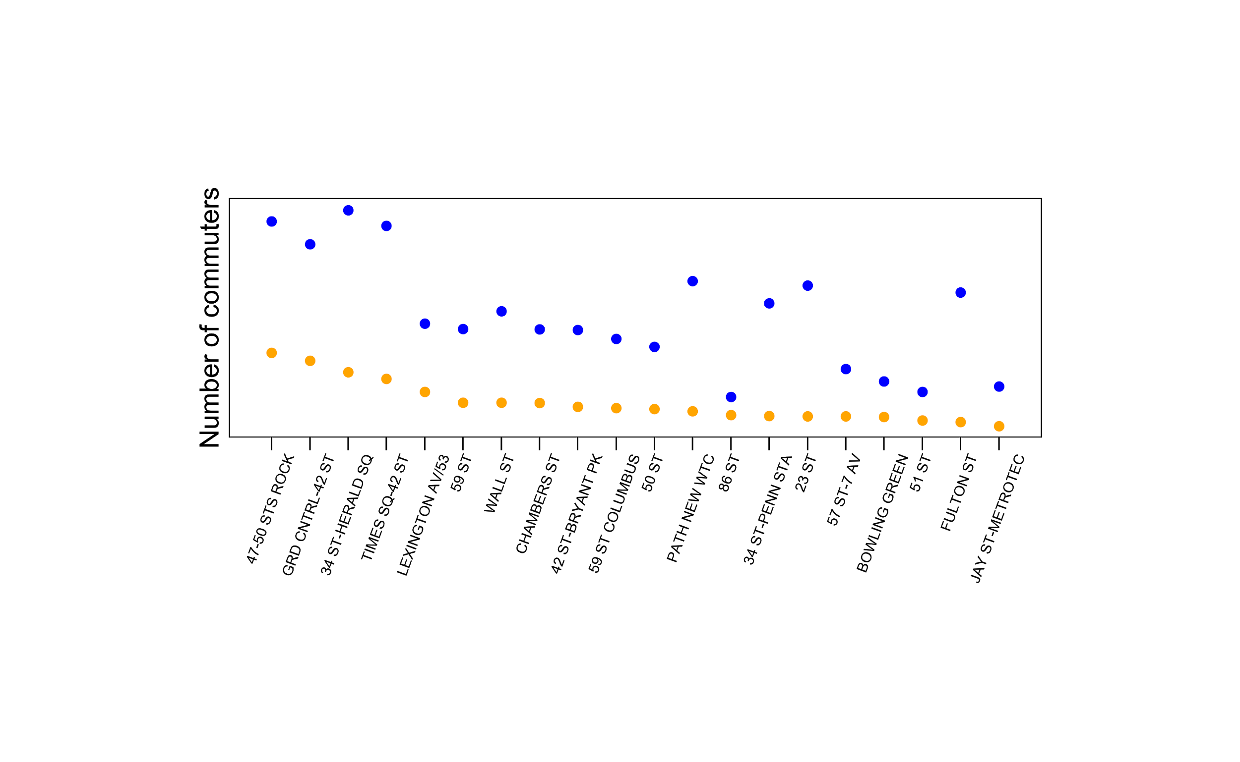
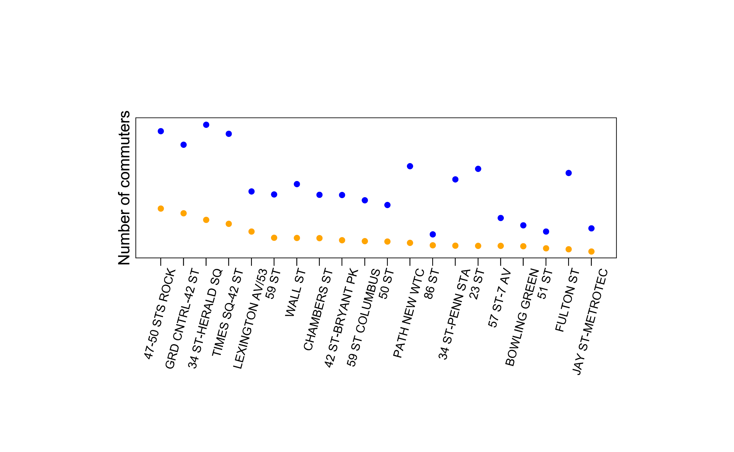
Rush Hour: Morning Exits, Evening Entries
Commuter station: Busy during rush hour vs. other times of day
Many entries in the evening to go home
Many exits in the morning to go to work
Notes:
Zoey

Slide 7
Rush Hour: Morning Exits, Evening Entries
Commuter station: Busy during rush hour vs. other times of day
Many entries in the evening to go home
Many exits in the morning to go to work
Most top 10 busy stations are commuter stations
Notes:
Zoey

Slide 8
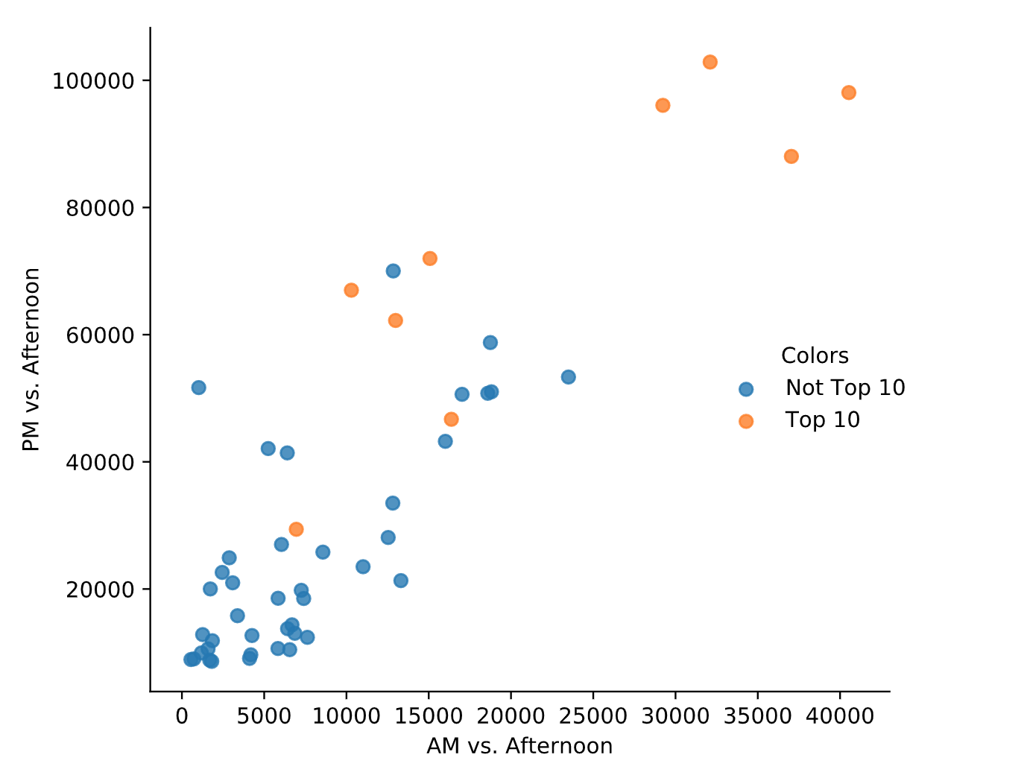
Notes:
Potential slide to add on to previous slide? This would be optional so we can decide if we want to include this plot in the morning.

Slide 9
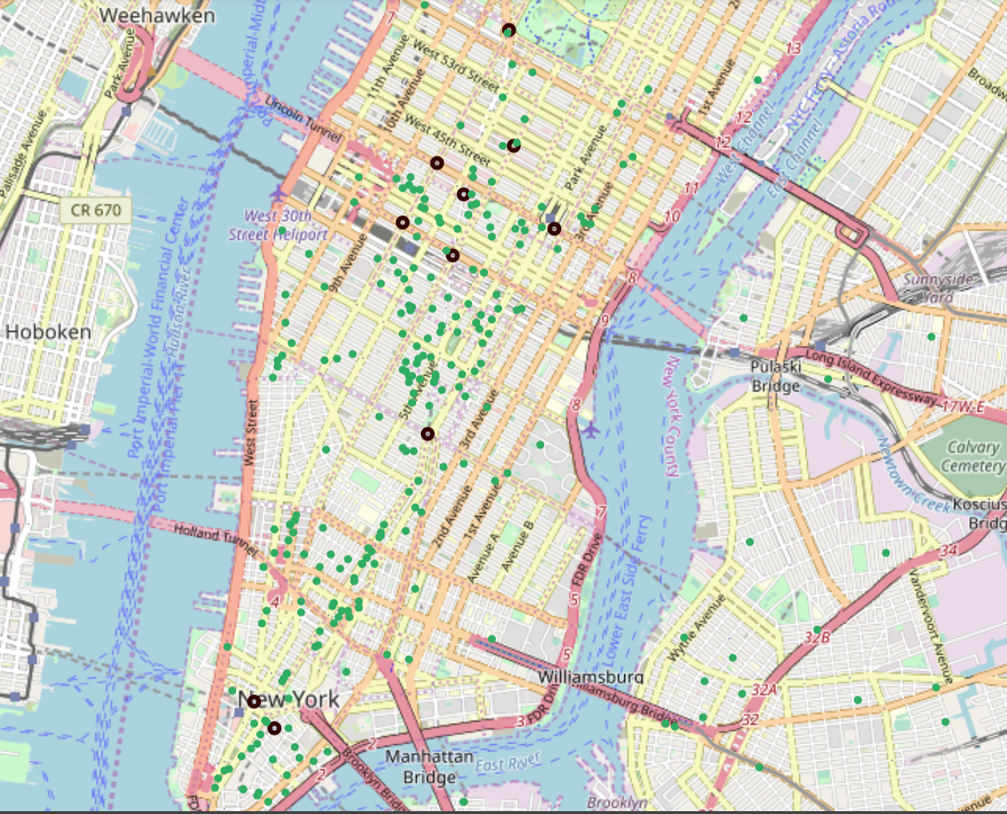
Mapping Data: Proximity to Tech Employers
Notes:
Abi

Slide 10
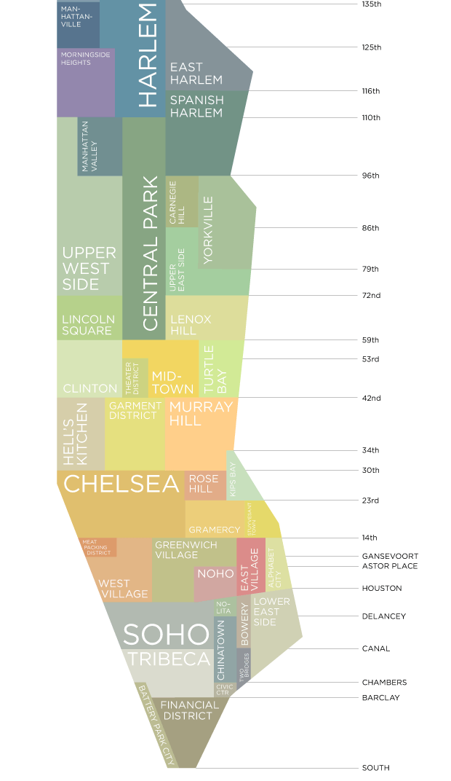
Station Recommendations
Four stations are near tech centers and fit the commuter station profile
Financial District
Fulton St.
World Trade Center
Flatiron District
23rd St
Midtown
Penn Station
Tech
Commuter Stations
Notes:
Abi: List the Stations
Zoey: Talk about canvassing in the evening
Max: Talk about canvassing in the middle of the week

Slide 11

Opportunities for further development
Refine to target high income tech workers
Look at where the commuters are coming from
Incorporate behavioral psychology
Canvas near home or work?
Model optimal granularity of street team deployment
Use size, availability of street team
Incorporate previous years’ conversion rates
Email signups → attendance
Notes:
Zoey

